Slide 1


NORTH CAROLINA 2020 ALL VIOLENT CRIME AND HOMICIDE DATA
EXEARIO D. BOSCAN
SYRACUSE UNIVERSITY
IST652 SCRIPTING FOR DATA ANALYSIS

Slide 2
INTRODUCTION
The purpose of this project is to conduct a data analysis with Python, an interpreted, object-oriented, high-level programming language with dynamic semantics. The analysis was done on the National Incident-Based Reported System (NIBRS). The NIBRS captures details on each single crime incident as well as on separate offenses within the same incident, to include information on victims, known offenders, relationships between victims and offenders, arrestees, and property involved in crime. Specifically, I researched crime data for North Carolina derived from the Federal Bureau of Investigations (FBI) Crime Data Explorer reports voluntarily submitted to the FBI.

Slide 3
Data subjects
a. All Violent Crime Offender vs. Victim Demographics (Offender Age, Victim Age).
b. All Violent Crime Victim Demographics (Location Type, Victim’s Relationship to the Offender).
c. All Violent Crime Offense Characteristics (Type of Weapon Involved by Offense, Offense linked to another offense).
d. Homicide Offender vs. Victim Demographics (Offender Age, Victim Age).
e. Homicide Victim Demographics (Location Type, Victim’s Relationship to the Offender).
f. Homicide Offense Characteristics (Type of Weapon Involved by Offense, Offense Linked to Another Offense).

Slide 4
Data sources
1. https://crime-data-explorer.app.cloud.gov/pages/home Main Federal Bureau of Investigations Crime Data Explorer page.
2. https://crime-data-explorer.fr.cloud.gov/pages/explorer/crime/crime-trend Main page to gather the crime data for North Carolina derived from the both the National Incident-Based Reporting System (NIBRS) and Summary Reporting System (SRS) voluntarily submitted to the FBI.

Slide 5
Method of analysis 1
Method of Analysis 1 | Data Input | Data Output
- Imported Pandas as pd. - Created a datapath equal to the csv file. - Created a function to read the file, extract the shape and the data frame. | CSV File | Data Shape and Dataframe
Method of Analysis 1 Code (Example)
import pandas as pd import numpy as np datapath = 'Rate-of-Violent-Crime-Offenses-by-Population12_10_2021.csv' rateofviolence_data = pd.read_csv(datapath, sep=',') rateofviolence_data.shape

Slide 6
Method of analysis 2
Method of Analysis 2 | Data Input | Data Output
- Utilized Python code to show visualization of csv files on each analyzed category | Dataframe and X,Y data | Bar chart
Method of Analysis 1 Code (Example)
NorthCarolina = [362.7, 346.3, 353.5, 341.0, 329.1, 346.1, 371.8, 370.4, 356.2, 378.7, 419.3] UnitedStates = [404.5, 387.1, 387.8, 369.1, 361.6, 373.7, 397.5, 394.9, 383.4, 380.8, 398.5] index = ['2010', '2011', '2012', '2013', '2014', '2015', '2016', '2017', '2018', '2019', '2020'] df = pd.DataFrame({'NorthCarolina': NorthCarolina, 'UnitedStates': UnitedStates}, index=index) ax = df.plot.bar(rot=0)

Slide 7
Formulated questions
1. What is the average offenders’ age?
2. What is the average victims age?
3. What was the most predominant location for crimes committed during 2020?
4. What was the victim’s relationship to the offender in homicide crimes?
5. What was the most predominant crime committed in North Carolina during 2020?

Slide 8
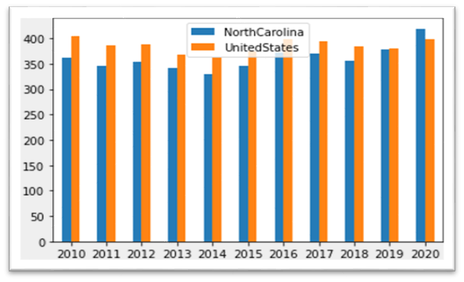
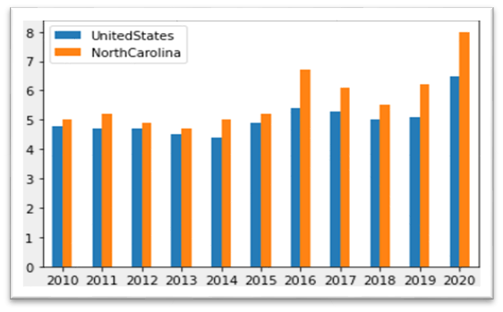
Rate of violence pop vs. rate of homicide
Rate of Violence Population
Rate of Homicide
Rate per 100,000 people by year
Rate of 100,000, by year. 683 Homicides

Slide 9
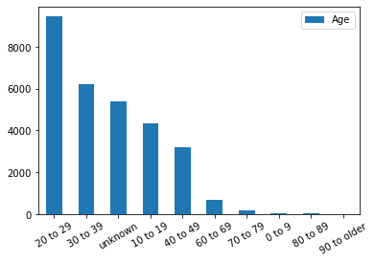
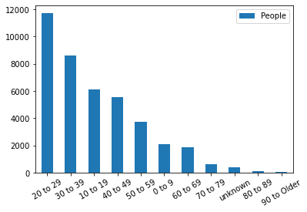
All violent crime offender age vs. victim age
Offender Age
Victim Age
11 Variables / 31,480 individuals / 20-29 most predominant age
11 Variables/ 40,939 individuals / 20-29 most predominant age

Slide 10
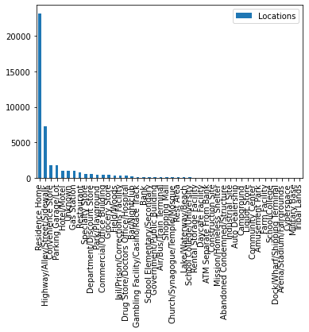
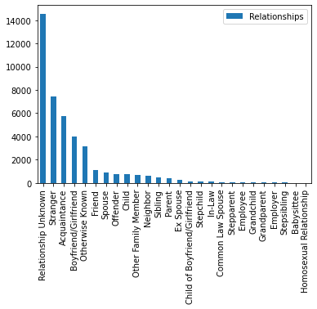
All violent crime Location type vs. victim relationship to offender
Location Type
Victim Relationship to Offender
46 Variables / 45,516 individuals / Residence Home most predominant location
26 Variables/ 41,777 relationships / Relationship unknown most predominant relationship

Slide 11
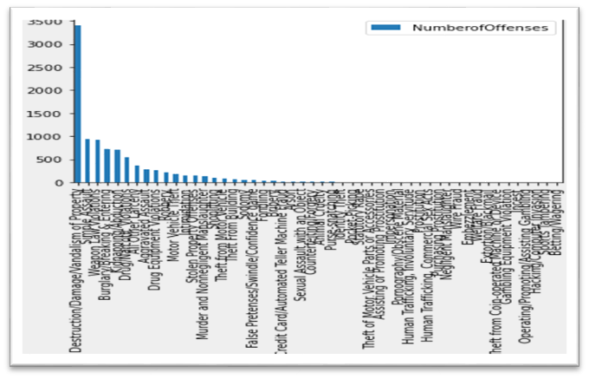
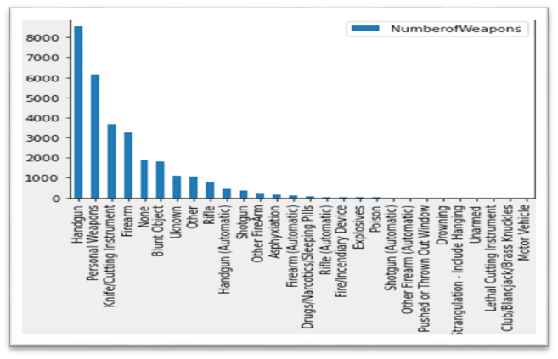
All violent crime offense linked to another offense and type of weapon
Offense Linked to Another Offense
Type of Weapon
50 Variables / 9,478 links / Destruction/Vandalism of Property most predominant link
28 Variables/ 29,796 weapons / Handgun was the most predominant weapon

Slide 12
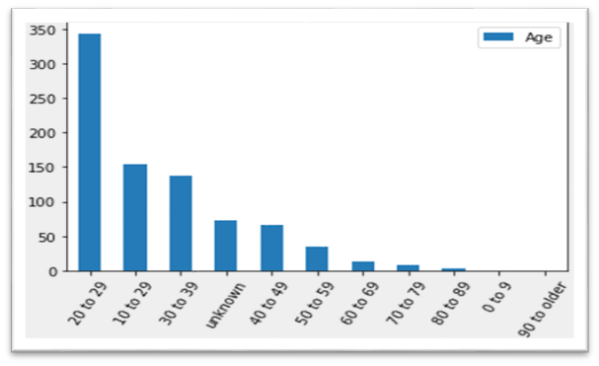
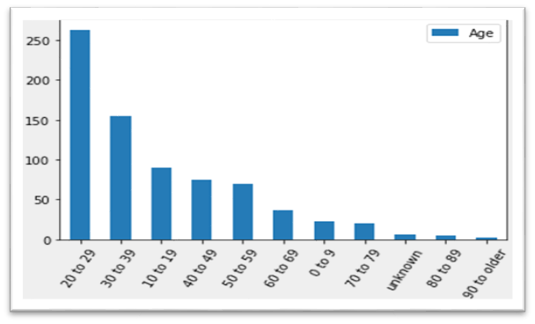
homicide offender age vs. victim age
Offender Age
Victim Age
11 Variables / 832 offenders / 20-29 most predominant age
11 Variables/ 732 victims /
20-29 most predominant age

Slide 13
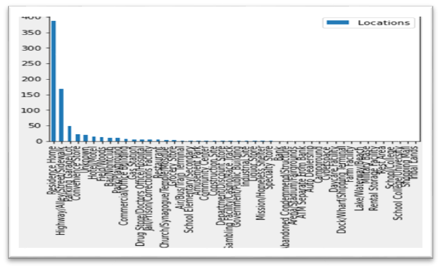
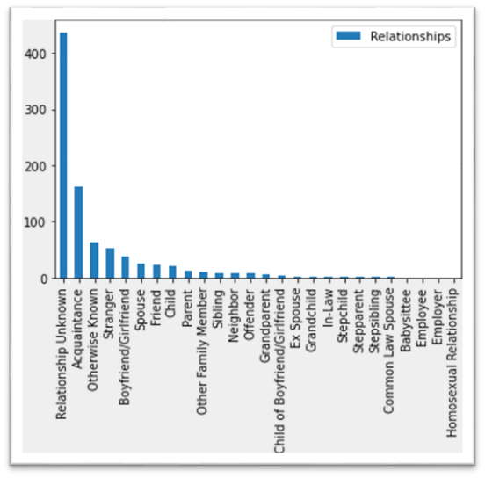
homicide Location type vs. victim relationship to offender
Location Type
Victim Relationship to Offender
46 Variables / 742 locations / Residence Home most predominant location
26 Variables/ 844 relationships / Relationship unknown most predominant relationship

Slide 14
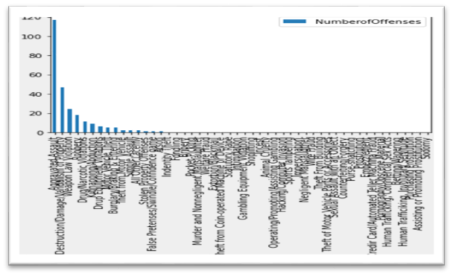
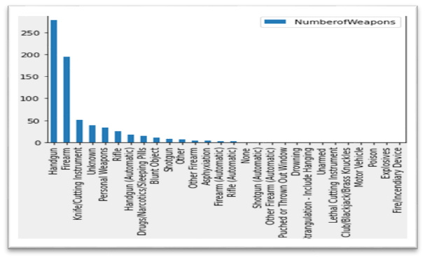
homicide offense linked to another offense and type of weapon
Offense Linked to Another Offense
Type of Weapon
50 Variables / 251 links / Aggravated Assault most predominant link
28 Variables/ 686 weapons / Handgun was the most predominant weapon

Slide 15
conclusion
According to the National Incident-Based Reporting System (NIBRS) in North Carolina, in 2020, there were 29,908 violent crimes incidents, and 39,880 offenses reported by 377 law enforcement agencies and which covered 90% of the population.
I analyzed All Violent Crimes and Homicides during 2020 in North Carolina in order to answer the questions I stated in my final project proposal.
1. What is the average offenders’ age?
Due to the nature of the data, I could not establish the average offenders’ age, but the ages from 20 to 29 is the predominant range with 9,470 offenders of all violent crimes. With regards to Homicides, the ages from 20 to 29, is the predominant range with 344 offenders.
2. What is the average victims age?
Due to the nature of the analyzed data, I could not establish the average victims’ age, but the ages from 20 to 29 is the predominant range with 11,727 victims in all violent crimes. With regards to Homicides, the ages from 20 to 29, is the predominant range with 263 victims.

Slide 16
conclusion
3. What was the most predominant location for crimes committed during 2020?
The most predominant location for all violent crimes was Residence Home with 23,207, and for homicides was Residence Homes with 387 instances.
4. What was the victim’s relationship to the offender in homicide crimes?
The most predominant relationship between victim and offender in all violent crimes is unknown with 14,599. For homicides, the most predominant relationship was also unknown with 437.
5. What was the most predominant crime committed in North Carolina during 2020?
The most predominant crime committed in North Carolinas was aggravated assault with 20,154.

Slide 17
references
1. https://crime-data-explorer.app.cloud.gov/pages/home Main Federal Bureau of Investigations Crime Data Explorer page.
2. https://crime-data-explorer.fr.cloud.gov/pages/explorer/crime/crime-trend Main page to gather the crime data for North Carolina derived from the both the National Incident-Based Reporting System (NIBRS) and Summary Reporting System (SRS) voluntarily submitted to the FBI.

